Slide 1
CMG Case Study
Data Harmonization and Revenue Estimation using Nowcasting Methods
Nathan Zhang, 2026/03/01

Slide 2
Process
Task
Provide a holistic Jan--Oct 2025 view of monthly accruals by delivering actual and estimated revenue and RPS across key dimensions using complete stream data to bridge revenue reporting delays.
EDA on Raw Data
Data Harmonization
Estimation and Testing
Reproducible Workflow
* Implementation and exploration details in Jupyter notebooks.

Slide 3
EDA and Identification of Problems
Variable of interests:
Time: Jan, 2025 -- Oct, 2025
Business units: 4
Major DSPs: 5
Amazon, Apple, Spotify, TikTok, YouTube
Major Territories: 10
USA, UK, Canada, Australia, etc.
Revenue (inaccurate): 1812 non-nulls, total_gross_amount
Stream (accurate): 2000 non-nulls, total_streams
Problems noted:
Dimension mismatch:
Revenue data: 27 DSPs, 10 major territories.
Stream data: 5 major DSPs, 250 countries.
High inaccuracies due to delay in reports.
Low readability due to noise and separate tables.
Next Step: data harmonization and quality augmentation through estimations.

Slide 4
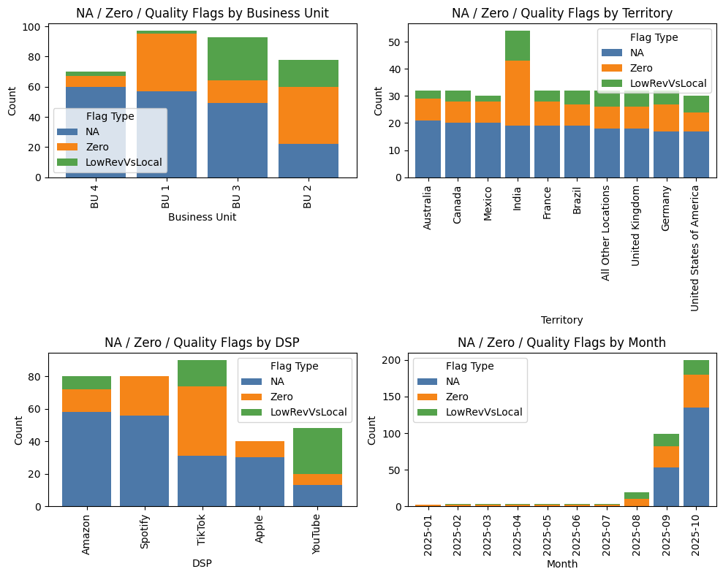
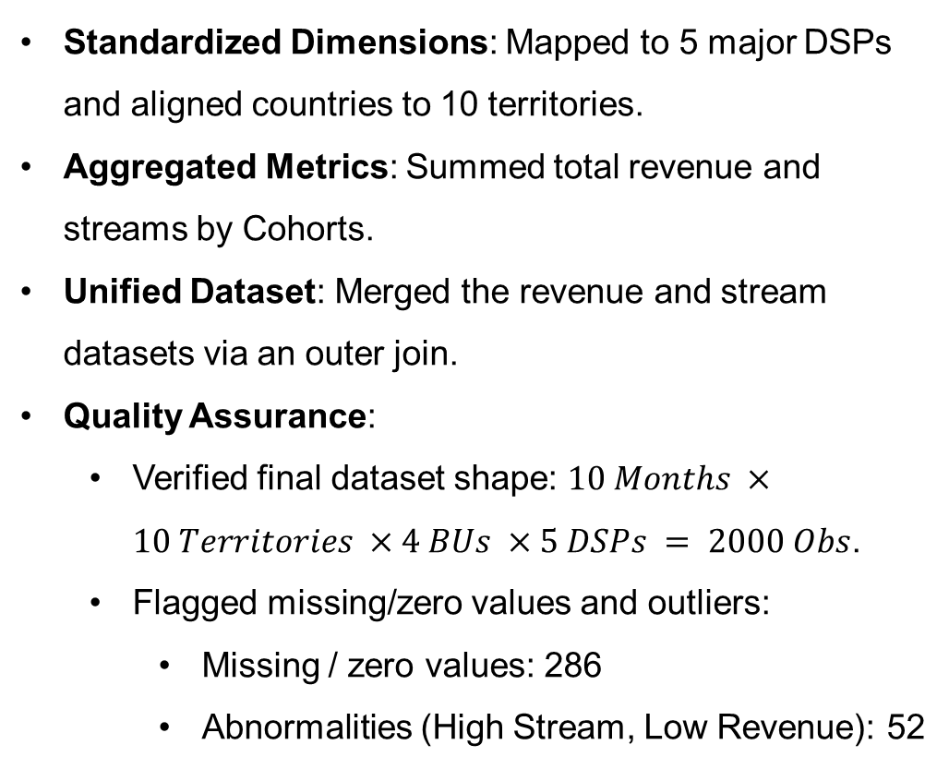
Data Harmonization
Standardized Dimensions: Mapped to 5 major DSPs and aligned countries to 10 territories.
Aggregated Metrics: Summed total revenue and streams by Cohorts.
Unified Dataset: Merged the revenue and stream datasets via an outer join.
Quality Assurance:
Verified final dataset shape: $10 Months ×10 Territories ×4 BUs ×5 DSPs = 2000 Obs$.
Flagged missing/zero values and outliers:
Missing / zero values: 286
Abnormalities (High Stream, Low Revenue): 52
Distribution of flagged data that requires feature-based imputations.

Slide 5
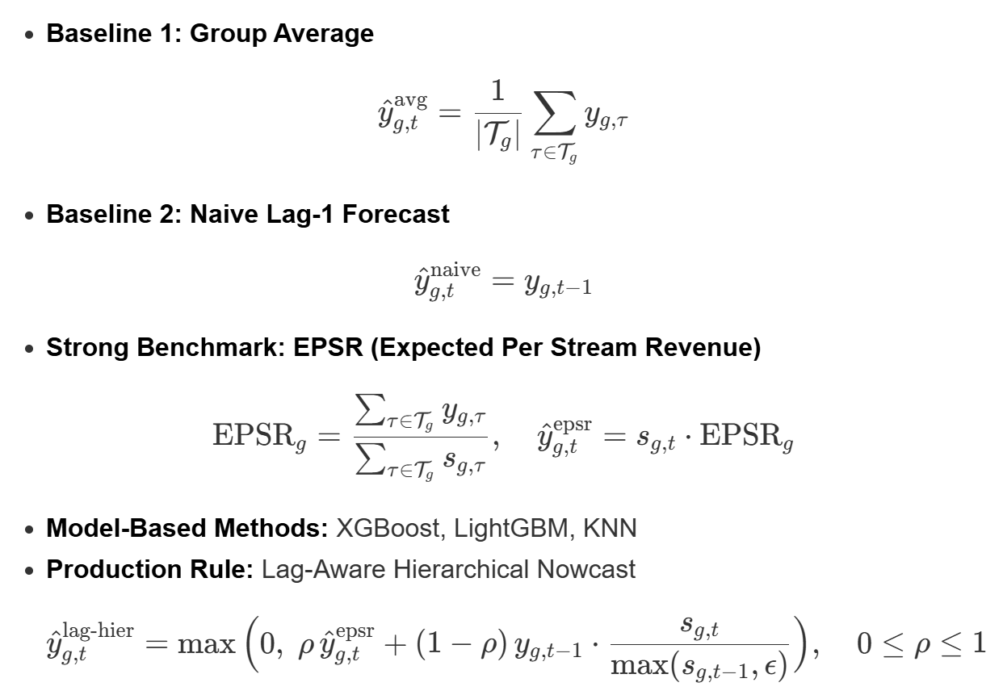
Estimation: Ensure Holistic Revenue Reports
Key Assumption: Stream data is complete and accurate, serving as an anchor for estimation.
ESPR-based Anchor
Add Lag Information
Apply Smoothing
Ensure Value Safety (> 0)
How does lag-aware hierarchical nowcast work?

Slide 6
Repeated Stress Test and Method Selection
Test Results (WMAPE, Reps = 30):
Selection Criteria:
Metrics: Evaluated accuracy using WMAPE and MAE under repeated stress tests.
Distributional: Analyzing the mean, standard deviation and percentile of the error distribution.
Model | Mean | P50 | P90
Lag-Hier | 0.1003 | 0.0946 | 0.1451
EPSR | 0.1020 | 0.0964 | 0.1464
Group Average | 0.1299 | 0.1292 | 0.1855
LGBM | 0.1666 | 0.1315 | 0.3141
XGBoost | 0.1761 | 0.1450 | 0.2884
Naive | 0.1871 | 0.1346 | 0.3723
KNN | 0.2738 | 0.2629 | 0.4206
Test Process:
Randomly mask known values.
Train on unmasked values and evaluate.
Repeat the test multiple times.
Study the distribution of errors.
Choose the most robust method.
Lag-Hier Nowcast appear to be the best.

Slide 7
Final Deliverables
Processed Data Structure:
Months and Cohorts of Interest
Baseline Metrics :
Included the total streams and reported gross revenue
The Predictions:
The final synthesized revenue figure (actual and pred).
Prediction Intervals (Nowcasted Values Only):
Lower and Upper bounds to quantify model uncertainty.
RPS (Revenue per Million Streams)
Audit and Quality Flags:
Categorical flags explaining why a data point was imputed and confirming its "nowcasted" status.
Category | Metric | Value
Total Volume | Total Rows Processed | 2,000
Data Source | Actual Data Rows | 1,662 (83%)
Data Source | Nowcasted Rows | 338 (17%)
Data Quality | Quality Flag | 52
Integrity | Severe Suspicious | 0

Slide 8
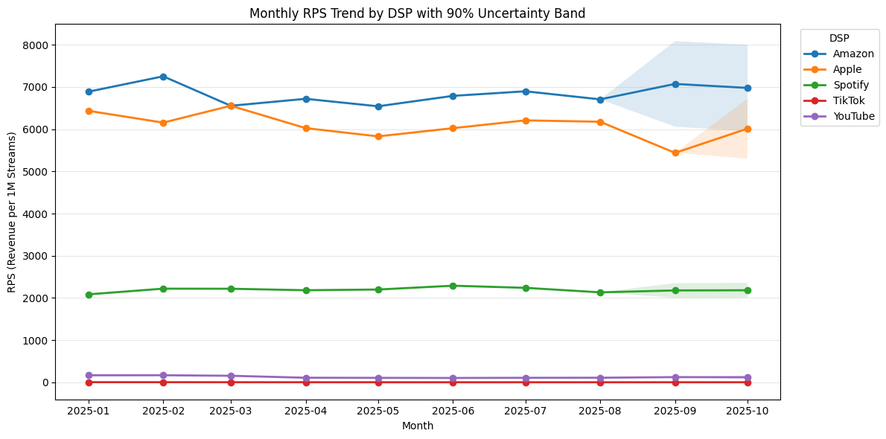
Findings and Discussions
Limitations and Future Improvement
Current Constraint: Limited historical data currently results in wide uncertainty bands and high model variance.
Data Enrichment: Integrate multi-year history and exogenous features like pricing and promos.
Advanced Modeling: Transition to more advanced probabilistic frameworks for granular risk quantification.
RPS by DSP exhibits consistent performance over time.
Forecasted data confirms the order of RPS rankings remained unchanged.
The output data was manually inspected to ensure no formatting anomalies exist.

Slide 9
Reproducible Workflow (Python Script)
SQL Harmonization
Quality Flagging
Estimation (Nowcasting)
Automatic Auditing
Export in Multi-formats
Packaged functions as utility scripts for easy reuse.
Process massive datasets more efficiently with SQL.
One-click re-run with clear output in csv and xlsx formats and auditable reports.
Finance team now has a complete, auditable monthly revenue view through Oct 2025 with a clear distinction between reported actuals and model-estimated values.

Slide 10

Thank you
Please see the attached Jupyter notebooks for details.
Nathan Zhang
2026/03/01

Slide 11
References
Hyndman, Rob J., Roman A. Ahmed, George Athanasopoulos, and Han Lin Shang. 2011. “Optimal Combination Forecasts for Hierarchical Time Series.” Computational Statistics & Data Analysis 55 (9): 2579–89. https://doi.org/10.1016/j.csda.2011.03.006.
Giannone, Domenico, Lucrezia Reichlin, and David Small. 2008. “Nowcasting: The Real-Time Informational Content of Macroeconomic Data.” Journal of Monetary Economics 55 (4): 665–76. https://doi.org/10.1016/j.jmoneco.2008.05.010.
Tashman, Leonard J. 2000. “Out-of-Sample Tests of Forecasting Accuracy: An Analysis and Review.” International Journal of Forecasting 16 (4): 437–50. https://doi.org/10.1016/S0169-2070(00)00065-0.

